Slide 1
Hospital Management System
BY Sushant Solanki

Slide 2
Introduction
A Hospital Management System (HMS) is a computerized system designed to manage and automate the day-to-day operations of a hospital or healthcare center. It helps in maintaining patient records, doctor details, appointments, billing, treatments, and medical history in a structured and efficient manner.
I created this Hospital Management System to understand how real-world healthcare data can be organized, stored, and retrieved efficiently using a database management system (MySQL). This project demonstrates the practical use of SQL concepts such as tables, relationships, joins, subqueries, views, and data manipulation in a real-life scenario.
The system reduces manual paperwork, improves data accuracy, saves time, and helps hospital staff access information quickly. It also ensures better coordination between departments like reception, doctors, pharmacy, and billing.

Slide 3
Problem Definition
In many hospitals, patient and hospital records are still managed manually using paper files or unorganized digital systems. This leads to several problems such as:
Difficulty in maintaining accurate patient records
Time-consuming search for patient or doctor information
Higher chances of data duplication and errors
Poor coordination between departments
Lack of proper report generation and analysis

Slide 4
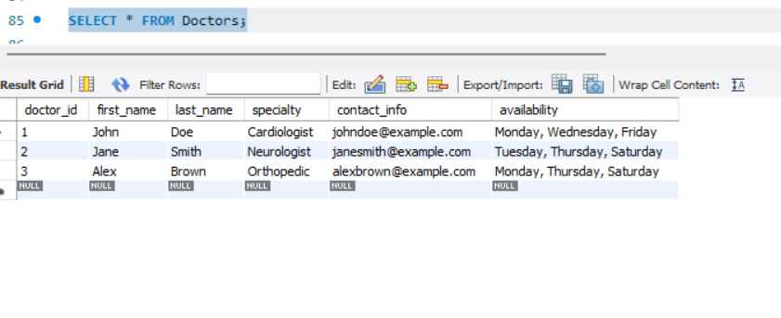
Display all Doctors

Slide 5
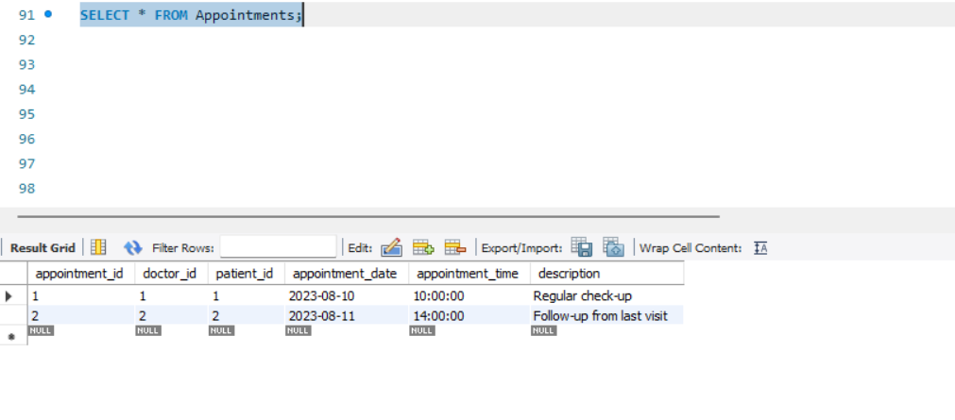
Show all appointments

Slide 6
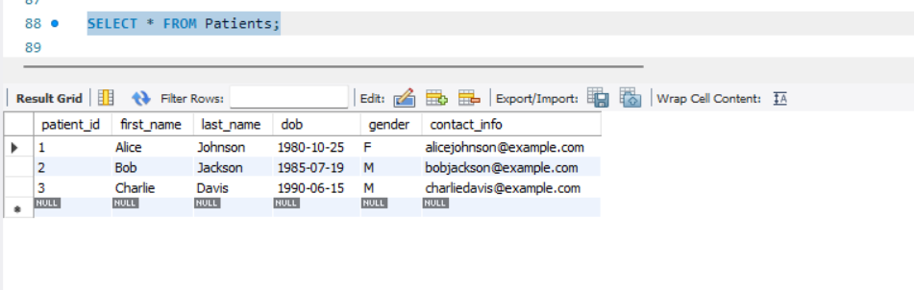
Display all Patients

Slide 7
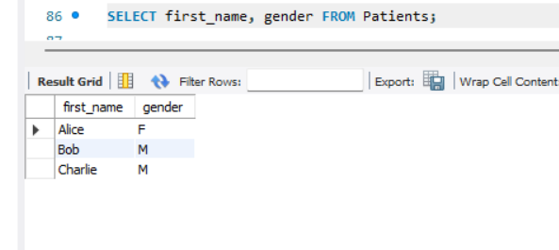
Display Patient gender and name

Slide 8
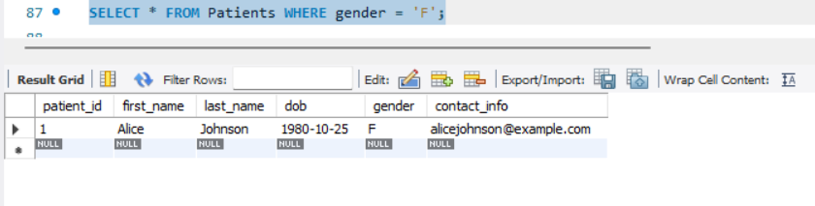
Find all female patients

Slide 9
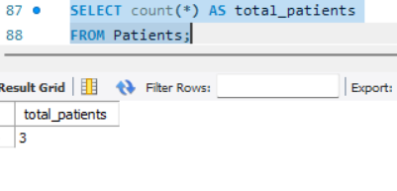
Count total patients

Slide 10
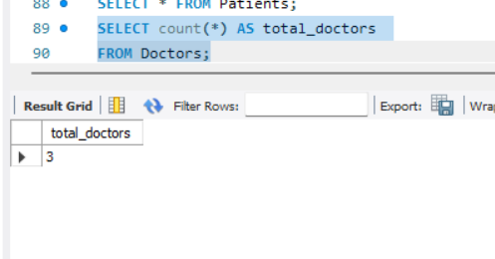
Count total doctors

Slide 11
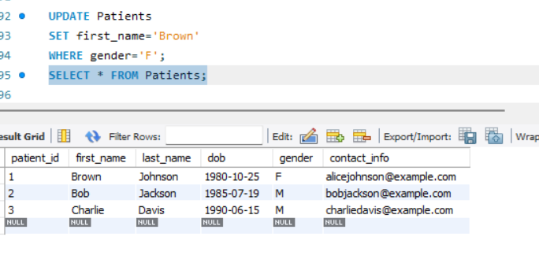
Update Female patient name

Slide 12
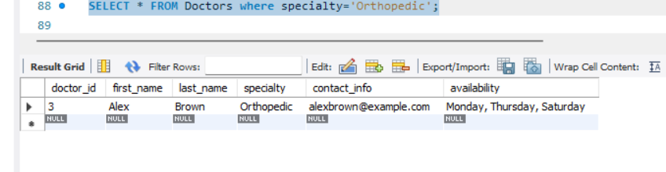
Show doctor by specialization ‘ortho’

Slide 13
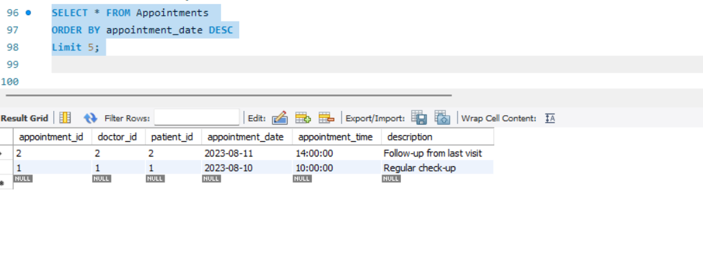
Show latest appointments

Slide 14
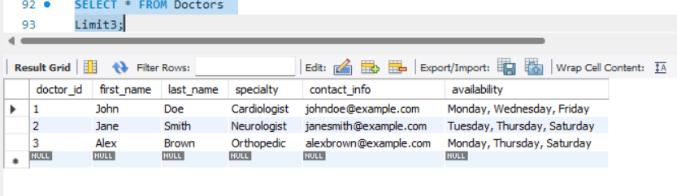
Display first three Doctors

Slide 15
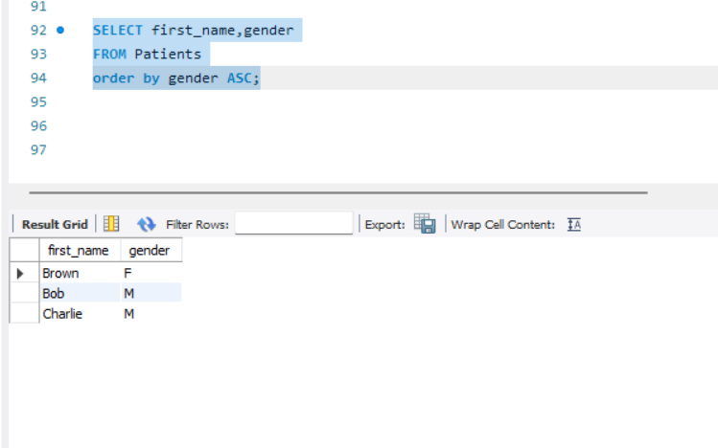
List patients ordered by gender

Slide 16
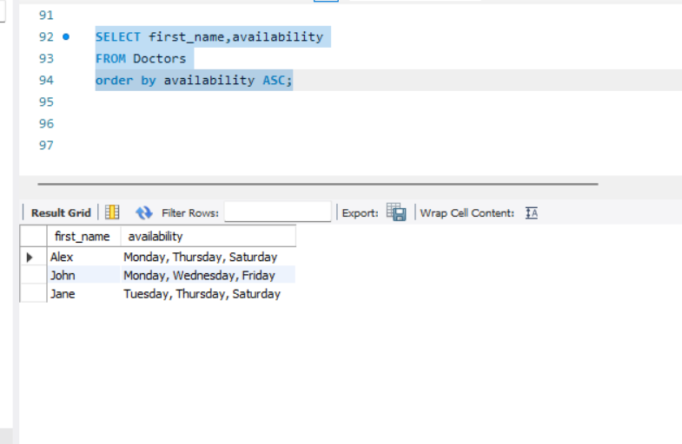
Display doctor order by availability

Slide 17
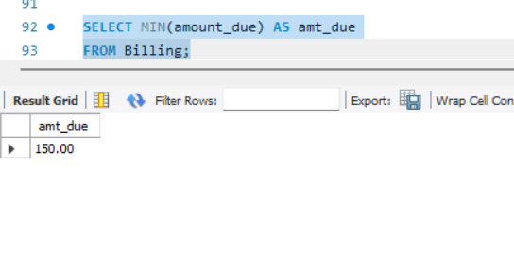
Display least amount due

Slide 18
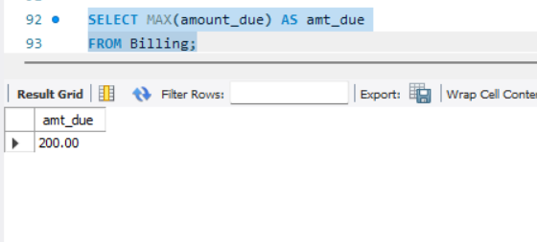
Show max bill amount

Slide 19
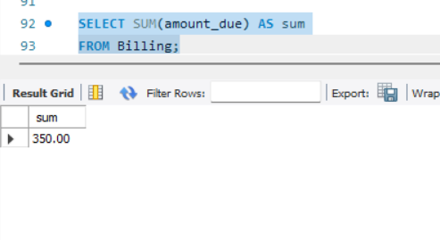
Show total revenue from billing

Slide 20
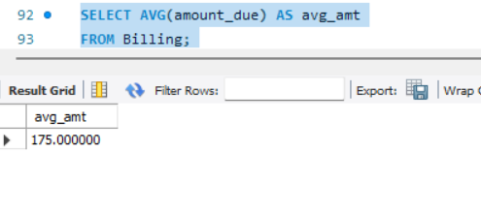
Show average Bill amount

Slide 21
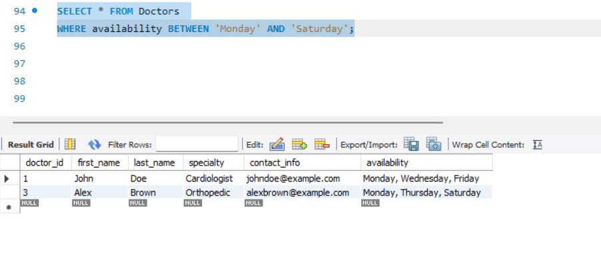
Display doctor available on Monday and saturday

Slide 22
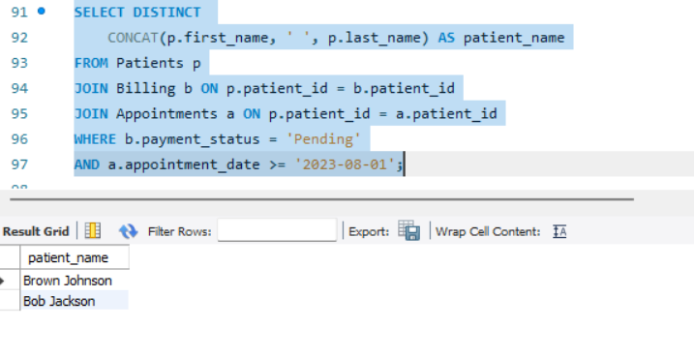
Display patients with pending payment recent appointments

Slide 23
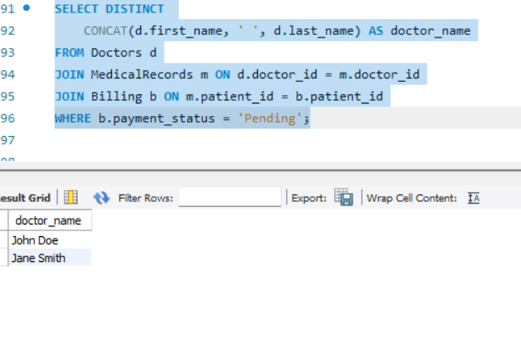
Doctor who treated patient with pending bills

Slide 24
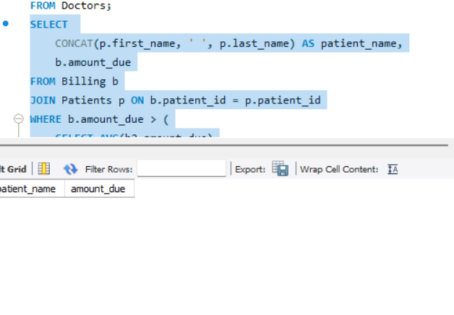
Patient whose bill is higher than their own average bill

Slide 25
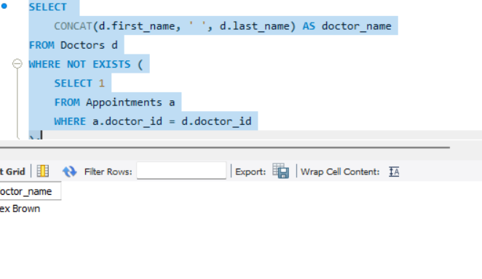
Doctor who never had an appointment

Slide 26
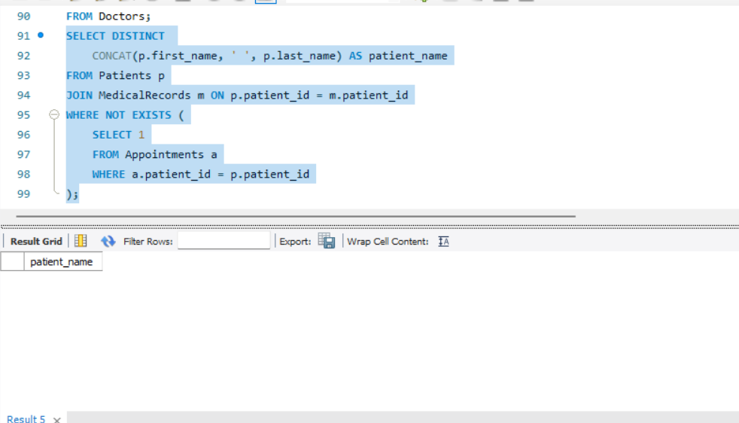
Patient who has medical record but no appointments

Slide 27
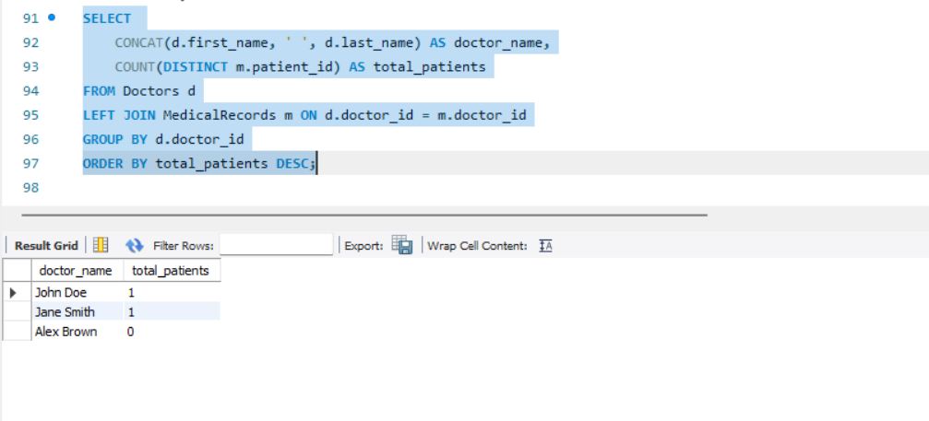
Rank doctor by number of patients treated

Slide 28
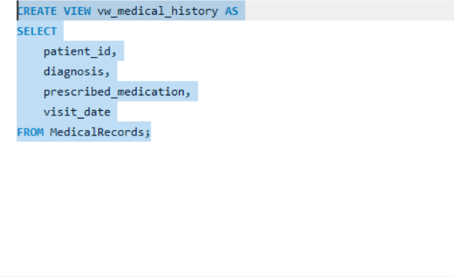
Create view medical history

Slide 29
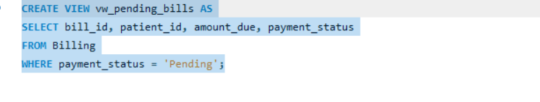
Create view for pending bills

Slide 30
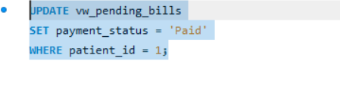
Update payment status of patient using view

Slide 31
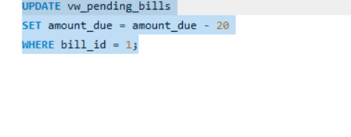
Reduce bill amt using view

Slide 32
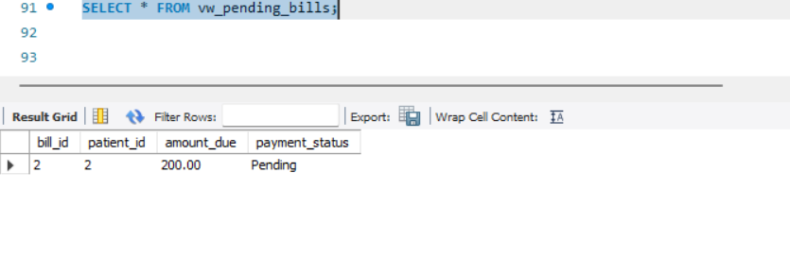
Check updated data from view

Slide 33
Conclusion
The Hospital Management System developed in this project successfully demonstrates how database management systems can be used to automate and manage hospital operations efficiently. By using MySQL, the system stores patient, doctor, appointment, treatment, and billing information in a structured and organized manner.
This project reduces manual paperwork, minimizes data redundancy, and improves data accuracy. It allows quick retrieval of information through SQL queries and provides better coordination between different hospital departments. The use of concepts such as tables, relationships, joins, and views helped in understanding real-world database design and implementation.

Slide 34
Thank You

